Slide 1

SnapSat
Critical Design Review
6th November 2015
Notes:
Good Morning etc.

Slide 2
Meet the Team
James Allworth – Attitude Determination and Control
Thomas Forbutt – Communications and On-board Data Handling
Oscar McNulty – Structural Design and Development
Penelope Player – On-board Computer and Power System
Nikita Sardesai – Thermal Control and Payload
Notes:
First lets start by introducing the team. If you have any questions, feel free to ask.

Slide 3
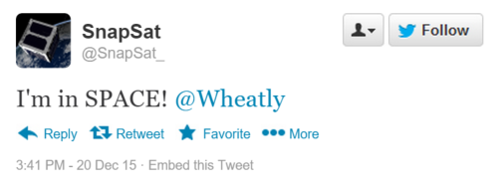
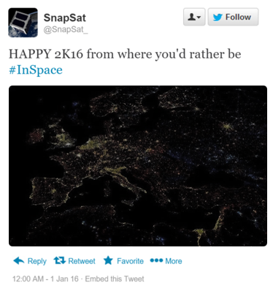
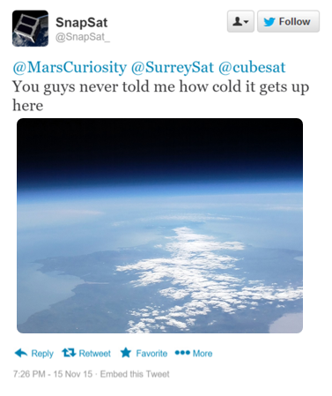
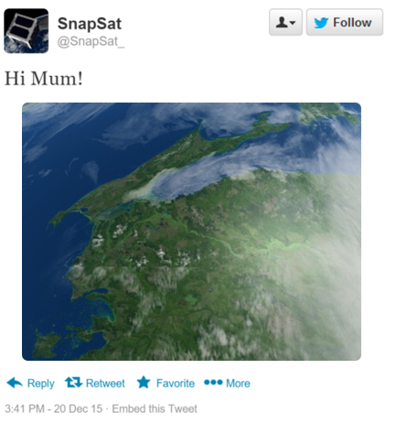
Our Mission
To bring space to YOU
Notes:
So what’s out mission? SnapSat is destined to be a satellite that is directly accessible to you!
SnapSat is a nano-satellite designed for outreach and space accessibility for educational bodies and the general public. In a sun-synchronous orbit at an altitude of 350km, SnapSat will be in the prime position of Earth observation. Users can send a message to the cubesat, which will take beautiful images of the Earth and tweet it to the world.
SnapSat will relay position data, so users are able to take photographs where they please. There is also scope for the development of a desktop/phone application for direct user connection to the satellite via groundstation.
Following the success the final build and launch, the team is hoping to lunch SnapSat on a sounding rocket - where it will stay in a LEO for about 3 months, taking beautiful photographs!
For example (These are hypothetical and not images taken with SnapSat. However, these are indicative of the quality of photos we are hoping to achieve):
SnapSat will relay position data, so users are able to take photographs where they please. There is also scope for the development of a desktop/phone application for direct user connection to the satellite via groundstation.

Slide 4
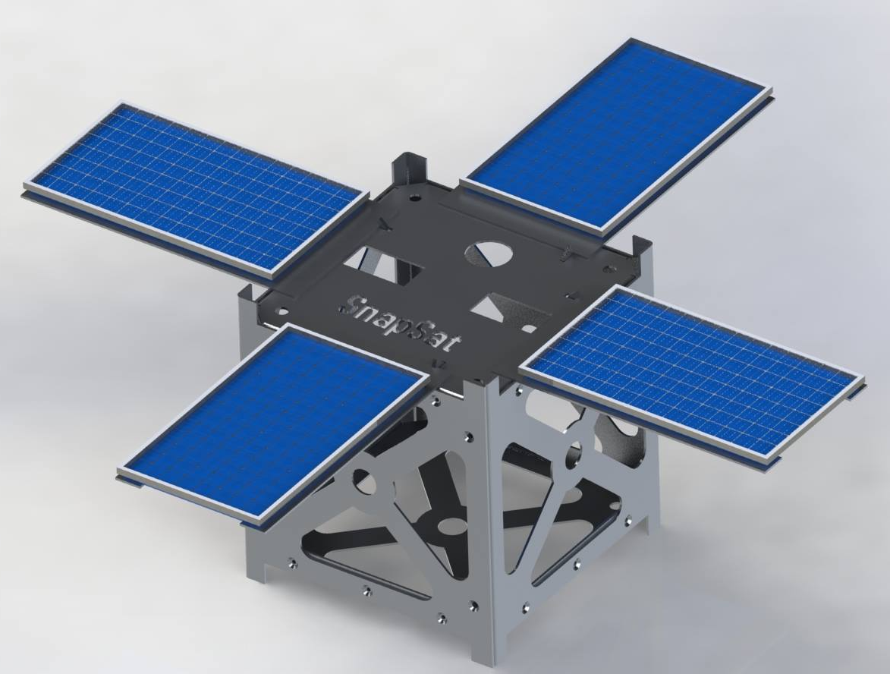
Design Point
1U Cubesat
$1000 budget
13 week timescale
Design for balloon launch to 30km
Communications: 5-node networking scheme
Figure 1 – Preliminary Design (this has since been improved upon)

Slide 5
Operation Overview
Component Selection and Operation

Slide 6
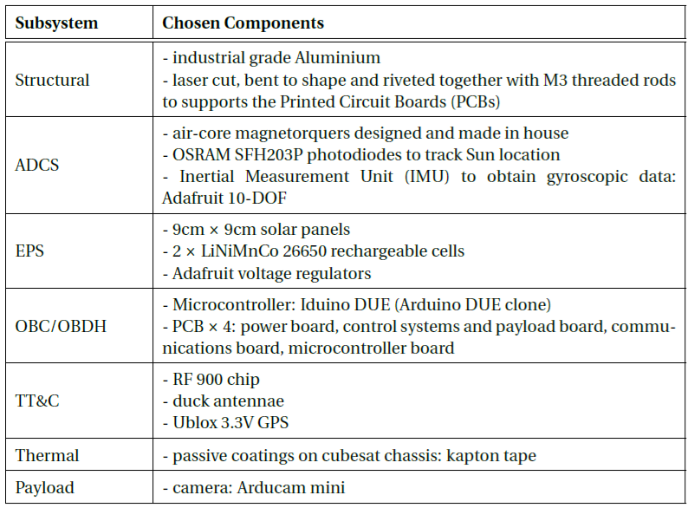
Component Selection

Slide 7
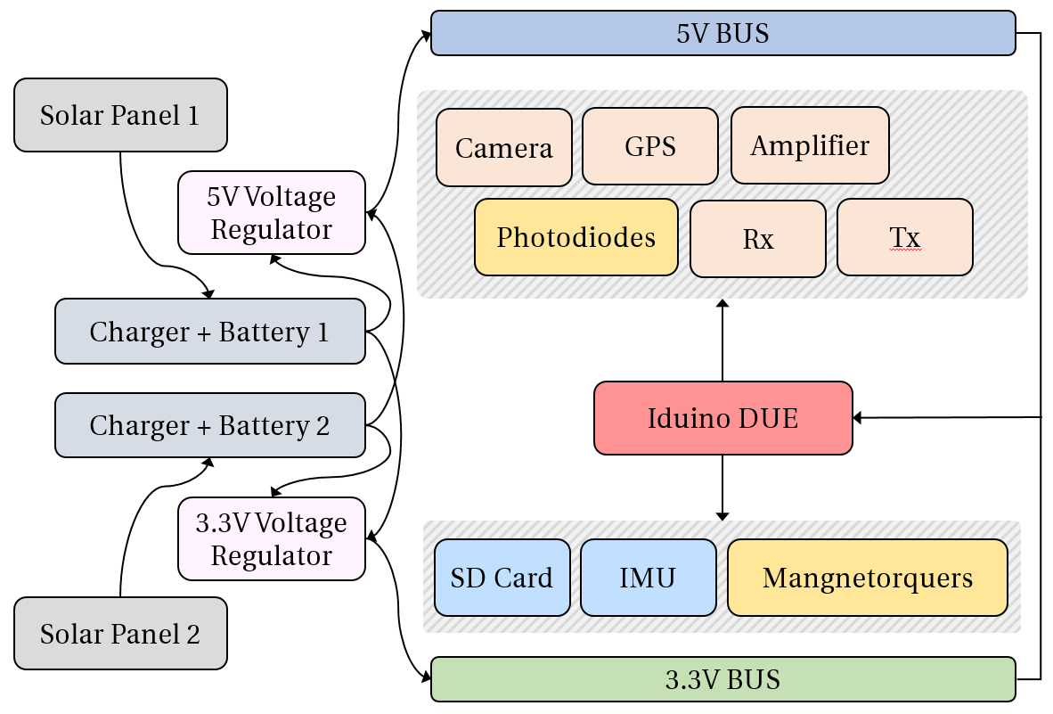
System Interaction

Slide 8
Structural Design
Oscar McNulty

Slide 9
Final Design

Slide 10
FEA Test Methodology
Natural Frequency
Sinusoidal Sweep
Random Frequency
Quasi-Static

Slide 11
Mass Budget
Subsystem | Component | Mass + Contingency | Fraction of total mass
Structural | Chassis – Laser cut Aluminium Solar Panels | 435 g | 47.6%
ADCS | Air core coils (in house) Osram photodiodes Adafruit 9DOF IMU | 180.2 g | 22%
EPS | Batteries & Power bus | 122 g | 14.9%
OBC / OBDH | Arduino DUE board Memory storage | 31.2 g | 3.8%
TT&C | Antennae VHF/UHF receivers/transmitters | 84 g | 10.3%
Thermal | Heat taping, Kapton tape Multi-layer insulation | 4.8 g | 0.6%
Payload | TTL Camera | 25 g | 3.1%
Integration | Wires, bolts and cables | 9.5 g | 1.2%

Slide 12
Mass Balance & Total Weight
Subsystem | Total Weight | Distance From Centroid | Inertial Contibution
Structural
ADCS
EPS
OBC / OBDH
TT&C
Thermal
Payload
Integration

Slide 13
Attitude Determination and Control (ADCS)
James Allworth

Slide 14
Attitude Determination
GPS
IMU
Sun Sensors

Slide 15
Attitude Control
GPS
IMU
Sun Sensors
Magnetorquers
Control System

Slide 16
Magnetorquer Design

Slide 17
Control System Design

Slide 18
Electrical Power System (EPS)
Penelope Player

Slide 19
System Specifications
Components
Charging Circuit
Voltage Rails
Battery Lifetime

Slide 20
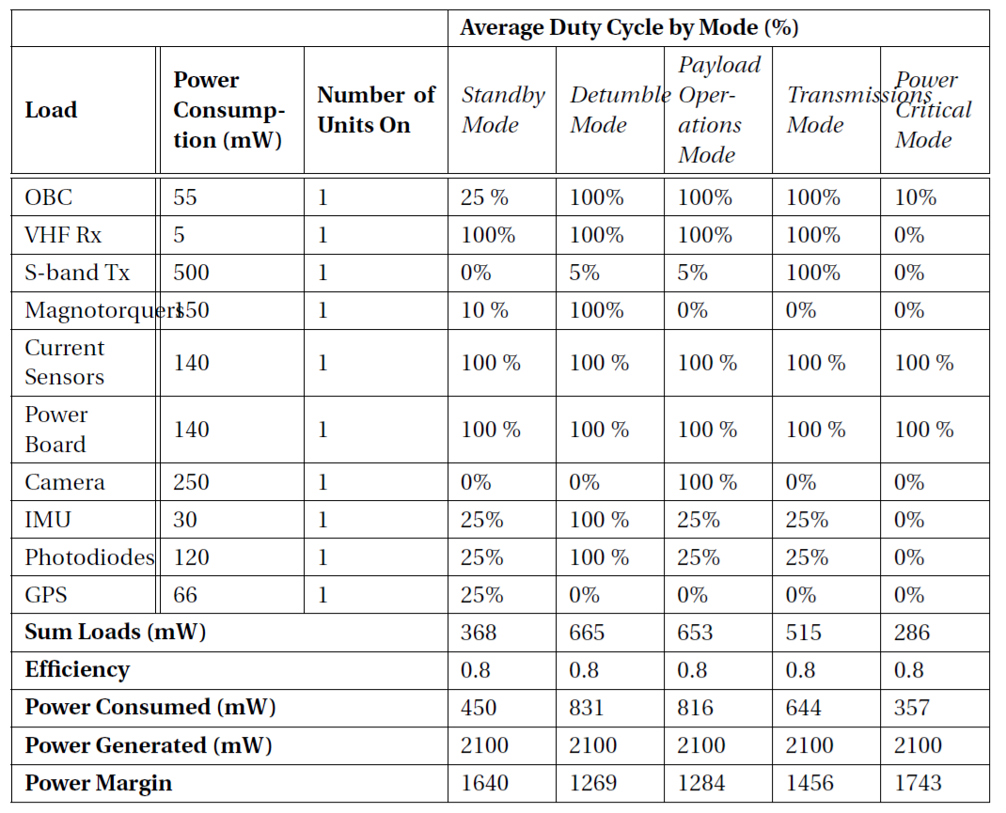
Power Budget

Slide 21
On-Board Computer and Data Handling (OBC/DH)
Penelope Player

Slide 22
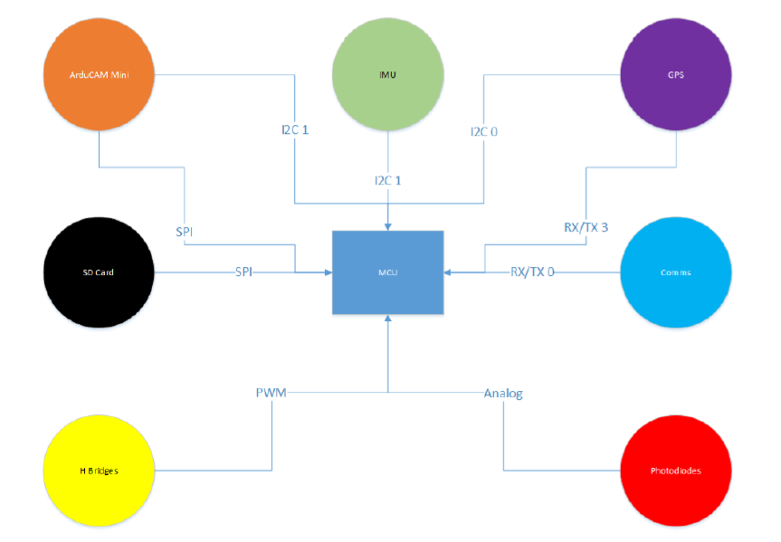
System Interactions

Slide 23
Communications
Thomas Forbutt

Slide 24
Components and Specifications
details

Slide 25
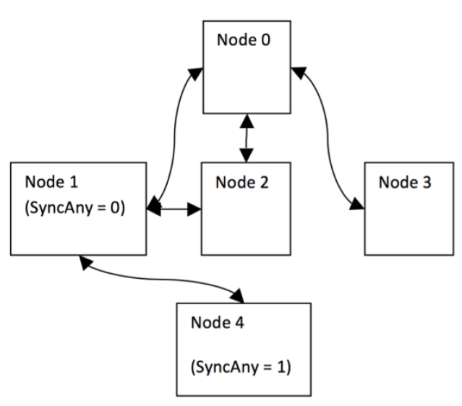
Five-Node Network Setup
details

Slide 26
Thermal Control
Note to snapsat: (this section is a bit too long – I will cut it down!)
Nikita Sardesai

Slide 27
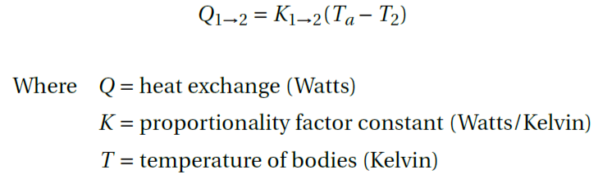
Space Thermal Dynamics
Model specified for 3 month, 350km orbit
Simplified mass: system dissipating heat to boundary exposed to space
General governing equation
Notes:
Go though component selection
Note: we were able to achieve such a high mass budget since expesive, space rated and optimised componenet were selected.

Slide 28
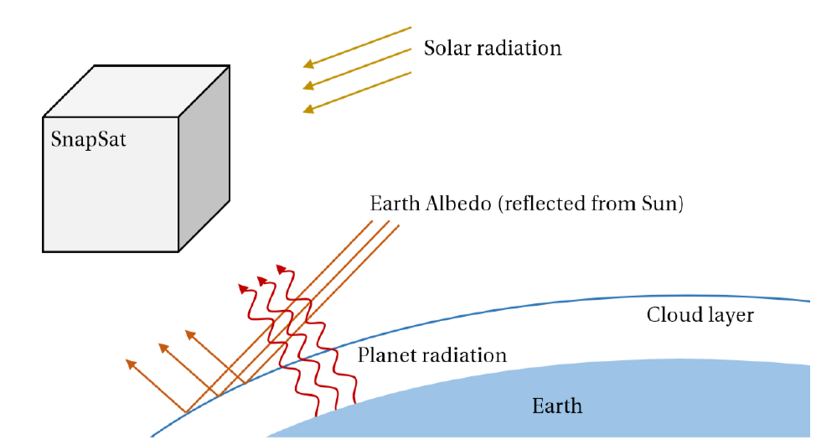
Space Thermal Environment
Notes:
Go though component selection
Note: we were able to achieve such a high mass budget since expesive, space rated and optimised componenet were selected.

Slide 29
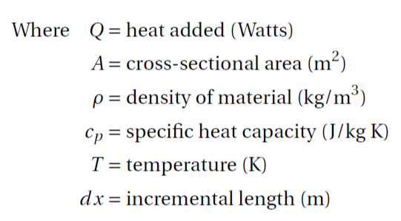
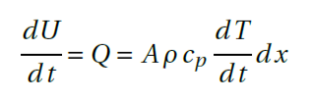
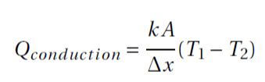

Heat Transfer Modes
Heat flux relates to a change in temperature as
Three modes:
Conduction
Convection (not relevant)
Radiation
Notes:
Go though component selection
Note: we were able to achieve such a high mass budget since expesive, space rated and optimised componenet were selected.

Slide 30
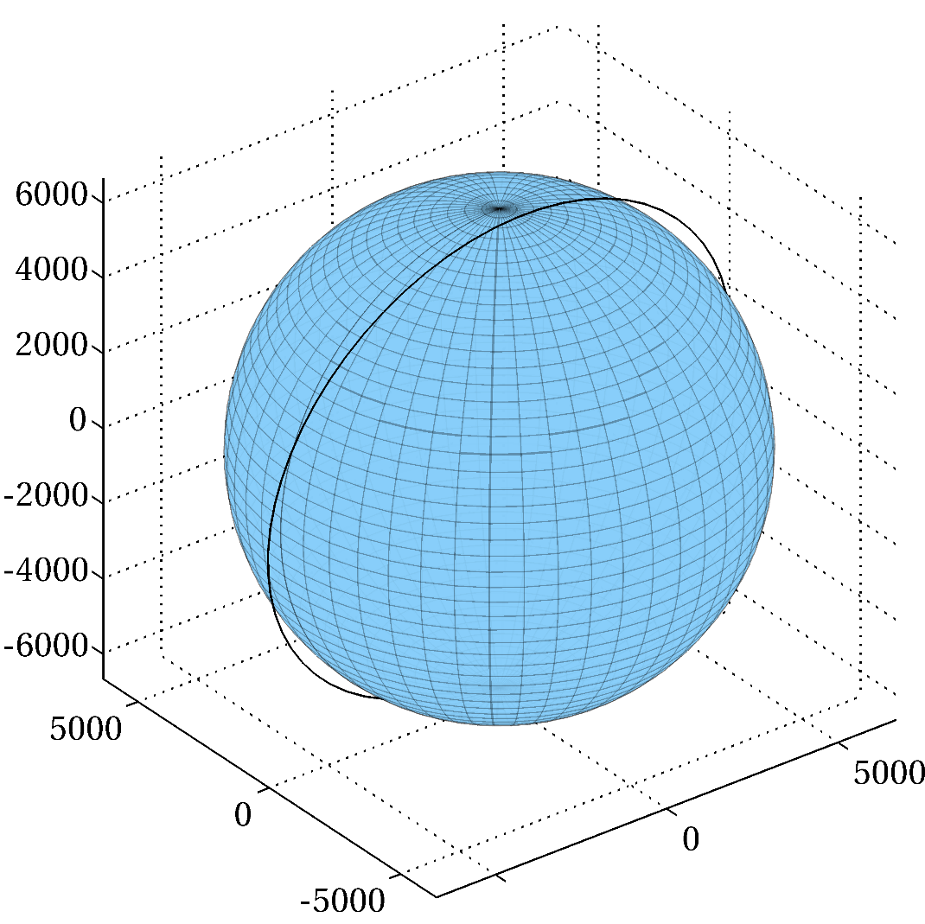
Total Incoming Radiation
Specification: sun-synchronous, 66% of orbit time spent in the sun, 98° inclination
Simulated orbit was rotated 45° about the z Earth-body axis and 8° about the y Earth-body axis
Notes:
Go though component selection
Note: we were able to achieve such a high mass budget since expesive, space rated and optimised componenet were selected.

Slide 31
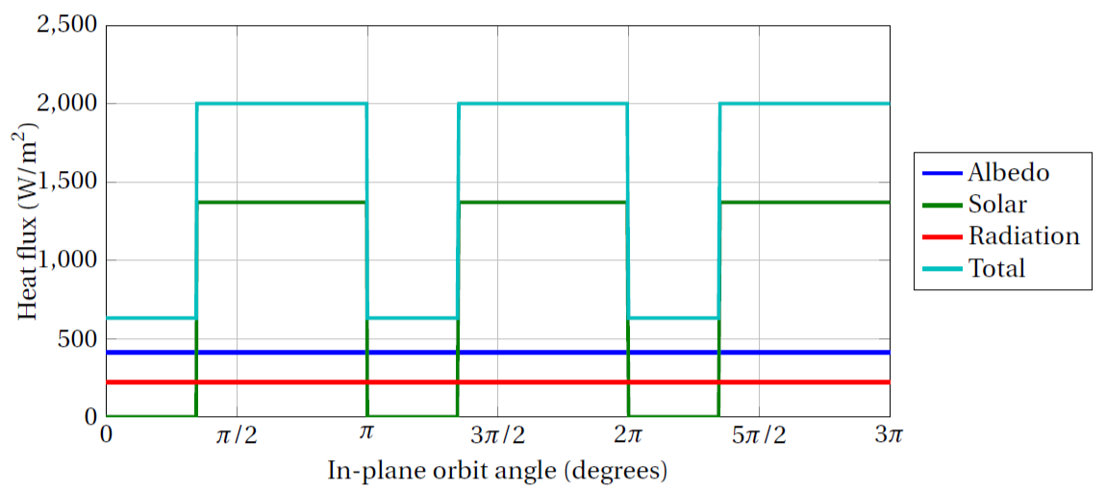
Total Incoming Radiation
Considering the external radiative fluxes
Albedo (constant = 0.3), Solar (absorptivity = 0.8), Earth-IR. This is NOT panel-by-panel
Notes:
Go though component selection
Note: we were able to achieve such a high mass budget since expesive, space rated and optimised componenet were selected.

Slide 32
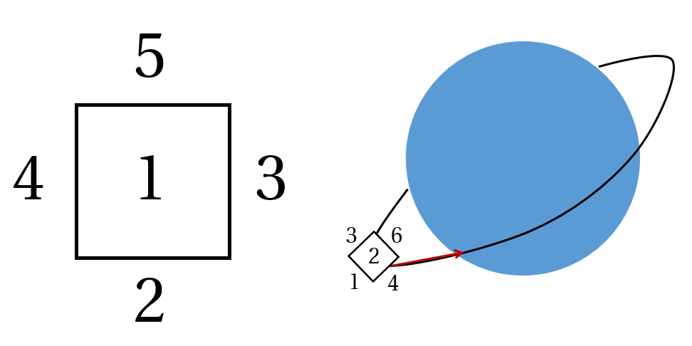
Panel Numbering
As a guide for the following slides
Notes:
Go though component selection
Note: we were able to achieve such a high mass budget since expesive, space rated and optimised componenet were selected.

Slide 33
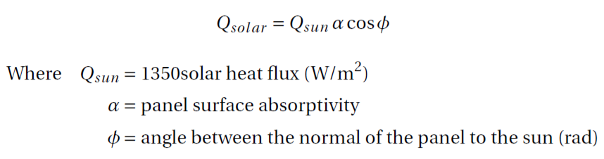
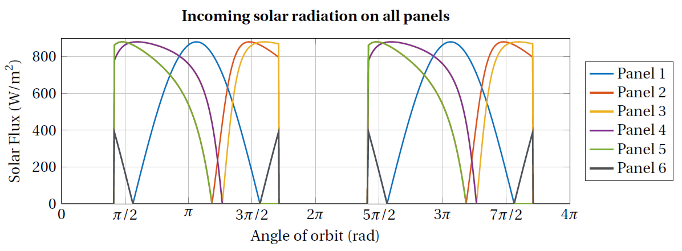
Solar Radiation Per Panel
Notes:
Go though component selection
Note: we were able to achieve such a high mass budget since expesive, space rated and optimised componenet were selected.

Slide 34
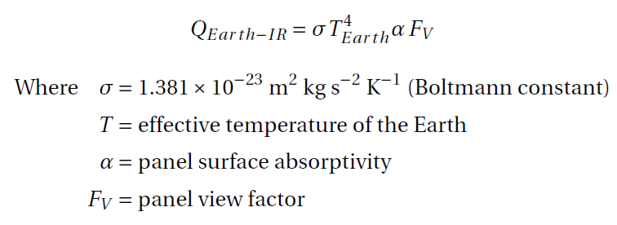
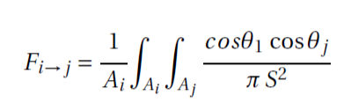
Earth Infrared Radiation
Constant value for each panel throughout orbit
View Factor: projected visible area given by
Notes:
Go though component selection
Note: we were able to achieve such a high mass budget since expesive, space rated and optimised componenet were selected.

Slide 35
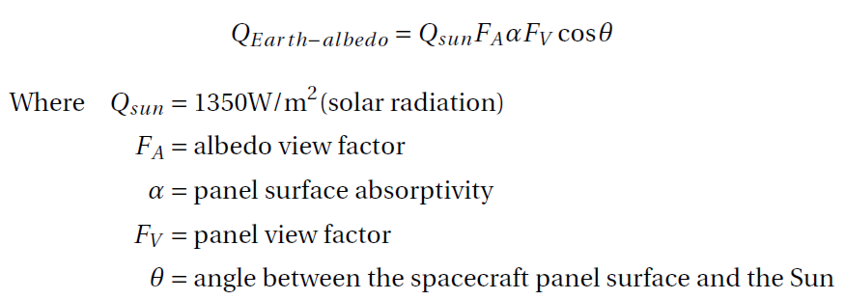
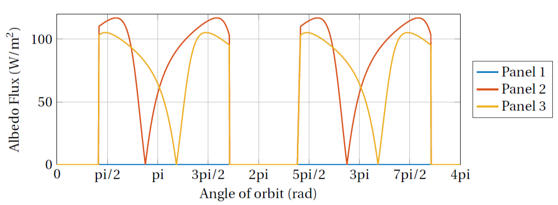
Earth Albedo
Albedo factor varies depending on the case considered
Notes:
Go though component selection
Note: we were able to achieve such a high mass budget since expesive, space rated and optimised componenet were selected.

Slide 36
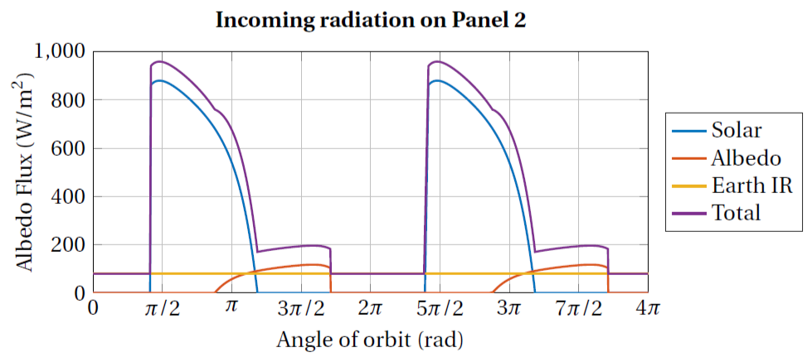
Total Panel Incoming Radiation
Shown here for Panel 2, but computed for all panels
Notes:
Go though component selection
Note: we were able to achieve such a high mass budget since expesive, space rated and optimised componenet were selected.

Slide 37
Temperature Change Per Panel
To be completed
Notes:
Go though component selection
Note: we were able to achieve such a high mass budget since expesive, space rated and optimised componenet were selected.

Slide 38
Concluding Remarks

Slide 39
Lessons Learned and Future Work
To be completed
Notes:
Go though component selection
Note: we were able to achieve such a high mass budget since expesive, space rated and optimised componenet were selected.

Slide 40
SnapSat
Critical Design Review
stemn.com/projects/cubesat-alpha

